Slide 1


Slide 2


Slide 3


Slide 4

Notes:
Intro
Born and Raised
Graphic design
Seattle
Web Design - self taught
CoSchedule

Slide 5
Notes:
Who is familiar or has used CSS?
Who liked it?
What is it?

Slide 6
It makes the web pretty.
Notes:
Wide variety of experience and knowledge, so ill try and stay in the middle, not too deep not too surface level
Examples for people who don’t really understand CSS

Slide 7
Without CSS
Notes:
Google without CSS

Slide 8
With CSS
Notes:
Google with CSS

Slide 9
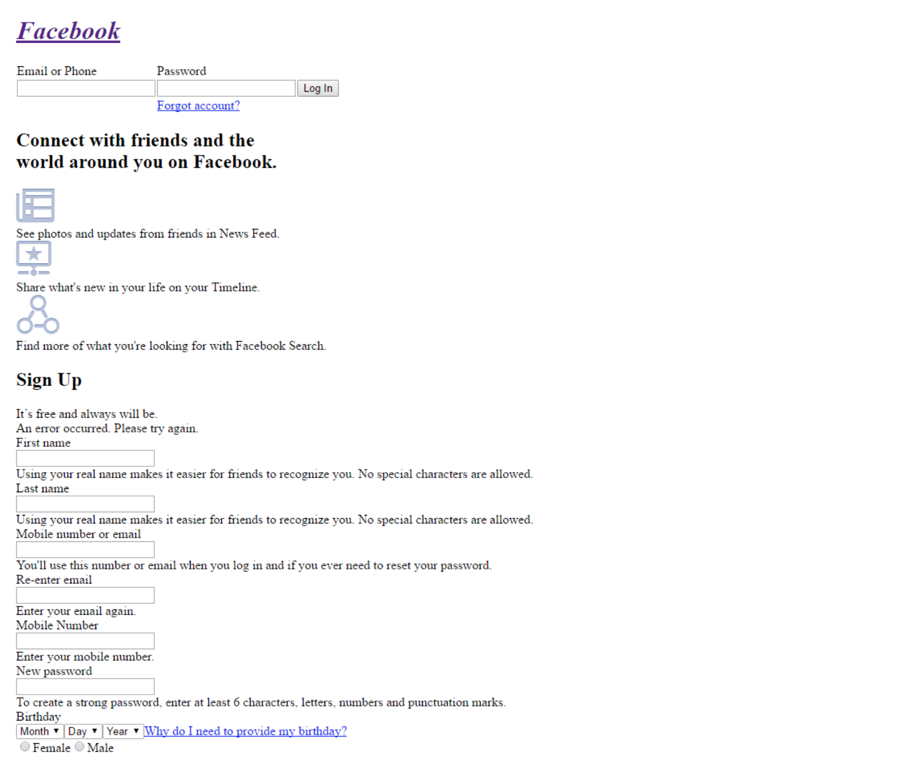
Without CSS
Notes:
Facebook without CSS

Slide 10
With CSS
Notes:
Facebook with CSS
love it or hate it
its important to the look and feel of the web

Slide 11
Learn CSS in 30 sec.
Notes:
quick example of basic css

Slide 12
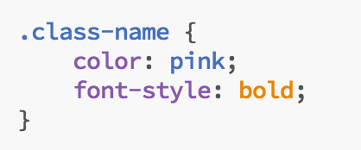
HTML CSS
RESULT
Hello World!

Slide 13
Learn CSS in 30 sec.
.class-name { // tells the browser which element on the page to attach the style to
.class-name .child-class-name .grandchild-class-name { // matches HTML hierarchy to make sure you are targeting the right area
.class-name.another-class-name.a-third-class { // add multiple classes to the same element for specificity or adding reusable styles

Slide 14
.css.the-old-way {
}
Notes:
The CSS most of us are used to
how i learned

Slide 15
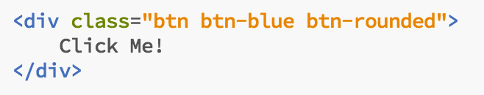
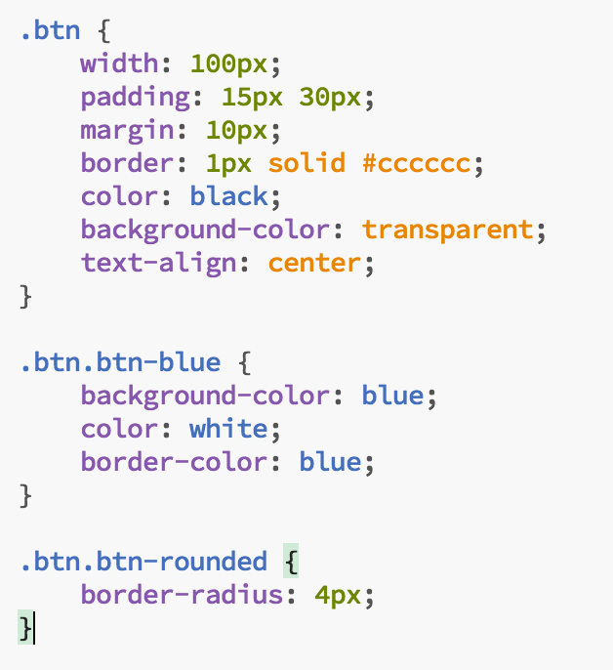

Notes:
Simple example
have to repeat class names to be more specific
doesn’t look that complicated

Slide 16
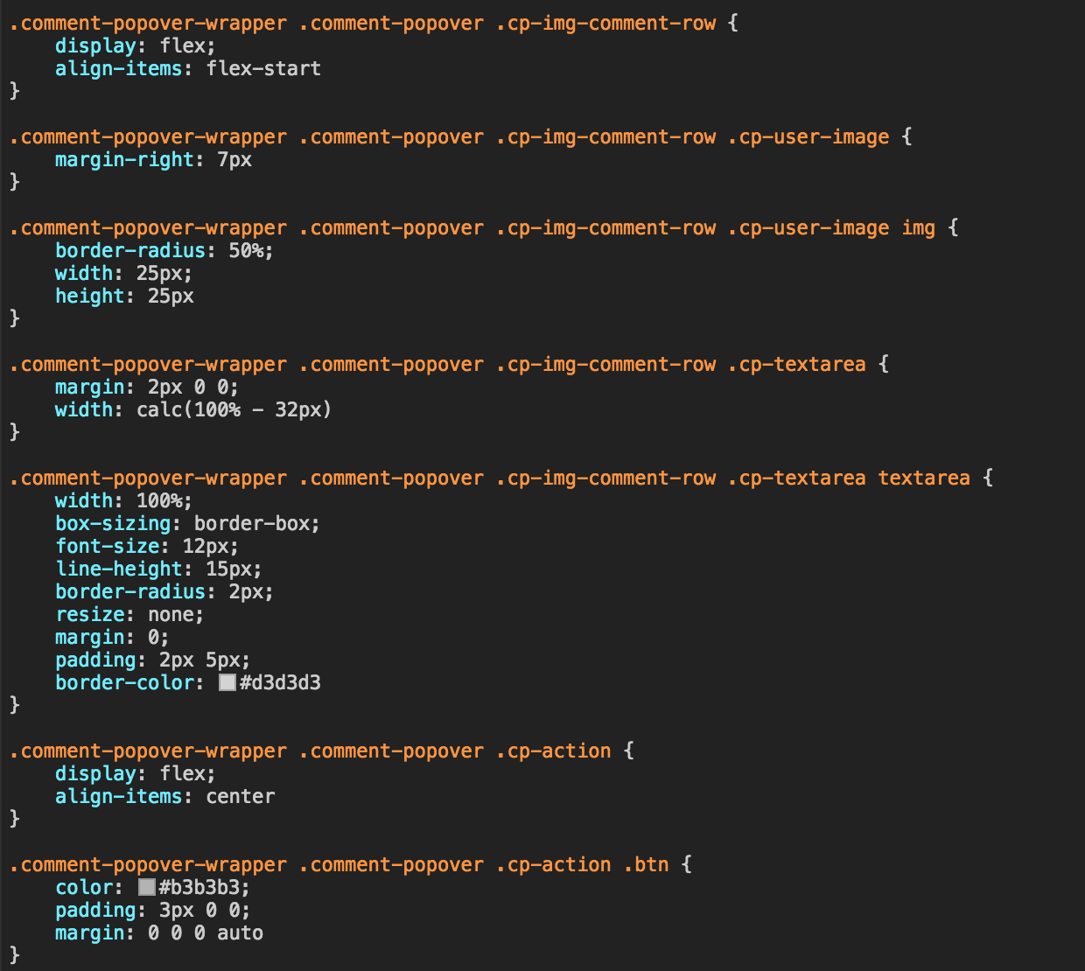
Notes:
Real word example of coschedule

Slide 17

.css.the-old-way { }
No nesting / hard to read
Lots of duplication and wasting time
Inefficient
Slow
Notes:
summery,
no nesting
hard to read
lots of duplication
pretty dumb as far as programming languages go
slow to write the same words over and over

Slide 18
There has got to be a better way.
Notes:
good news, theres a better way

Slide 19
.scss { &.the-new-way { } }
Notes:
SCSS or Sassy SCSS is a CSS compiler.
you can write it one way
compiler runs when your site builds
browser gets fed regular CSS that it can read

Slide 20
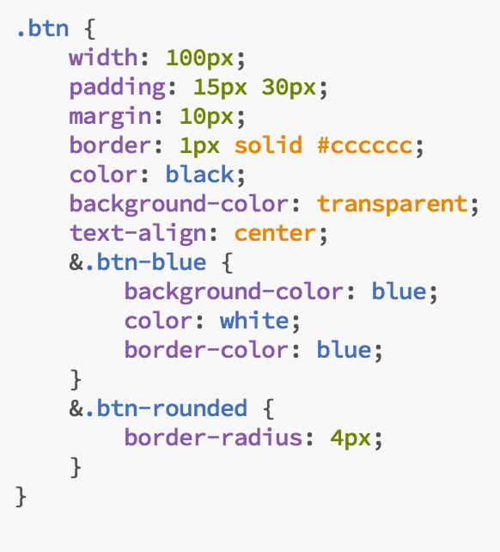
Notes:
Same example but with SCSS
saves a couple lines, a little duplication, easier to read

Slide 21
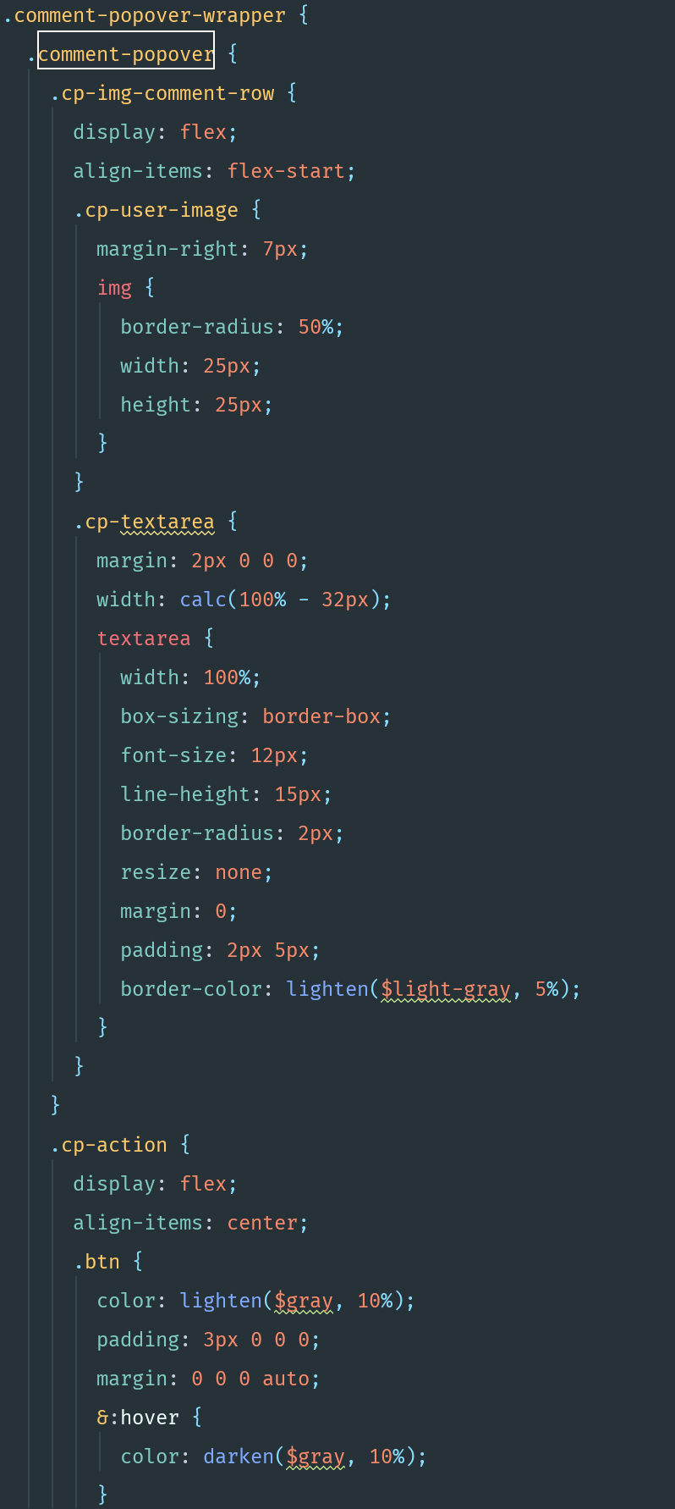
Notes:
real world example
no duplication
more organized hierarchy

Slide 22
.scss { &.the-new-way { } }
SCSS - Sassy CSS
Nested / Easier to read and organize
Reusable, less duplication
Efficient
Faster
Notes:
sassy css
nested and organized
reusable with less duplication
efficient and fast

Slide 23
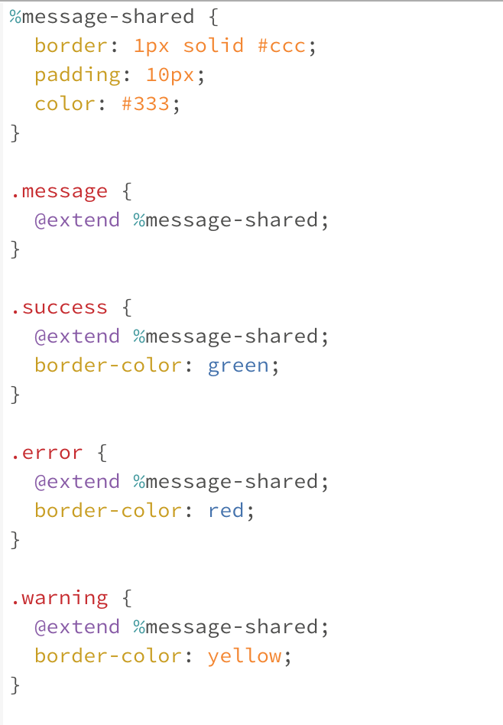
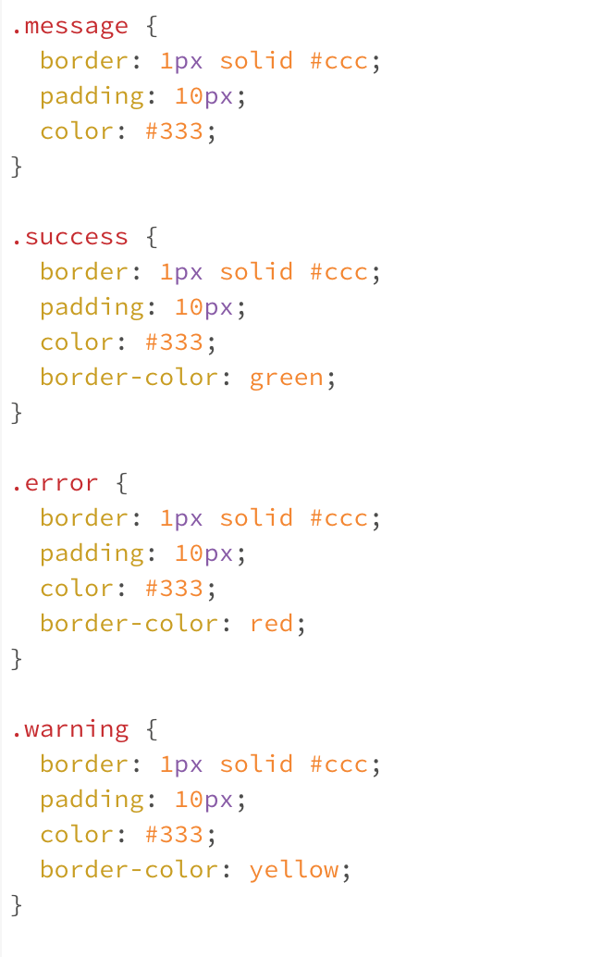
Extend/Inheritance
SCSS
CSS
Notes:
beyond the syntax and structure, its more powerful
here is placeholders and extends
create styles that you know will be used over and over
extend those styles into different classes without having to string lots of classes on a div

Slide 24
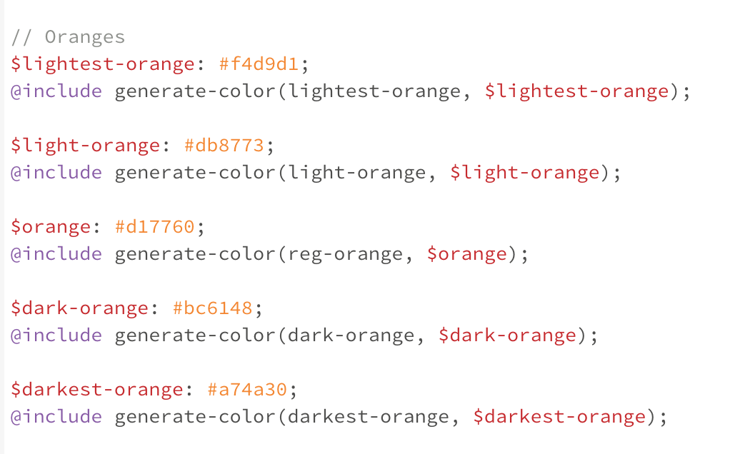
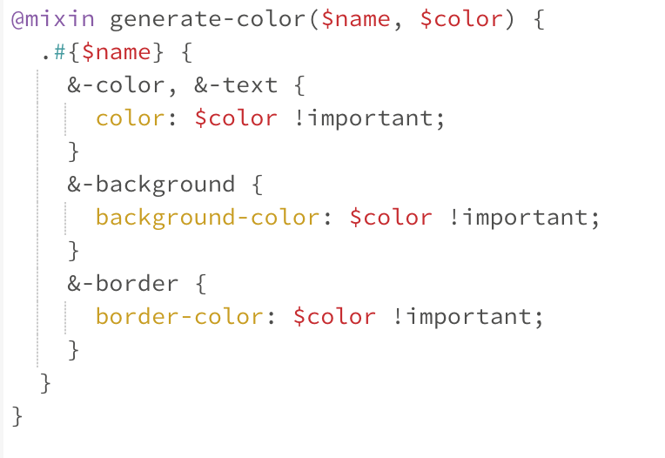
Mixins
SCSS
Notes:
mixins are super powerful
variables
generate lots of things

Slide 25
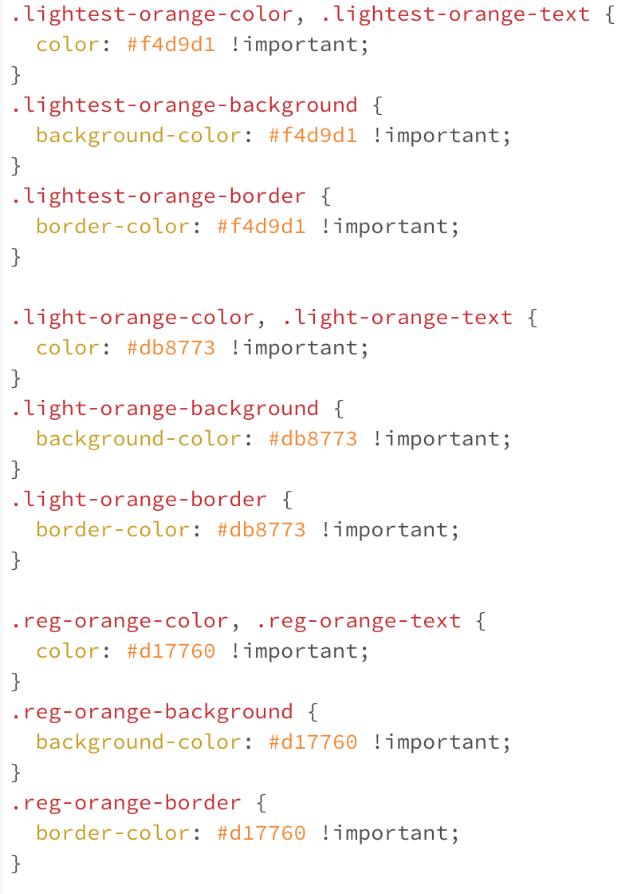
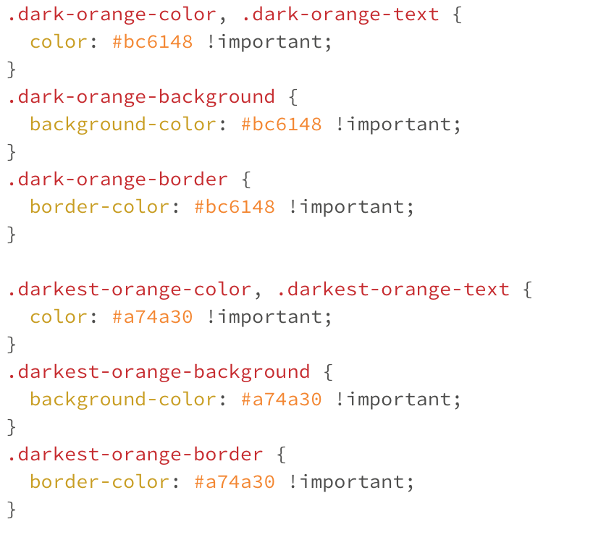
CSS
Notes:
compiled CSS
saved a ton of time

Slide 26
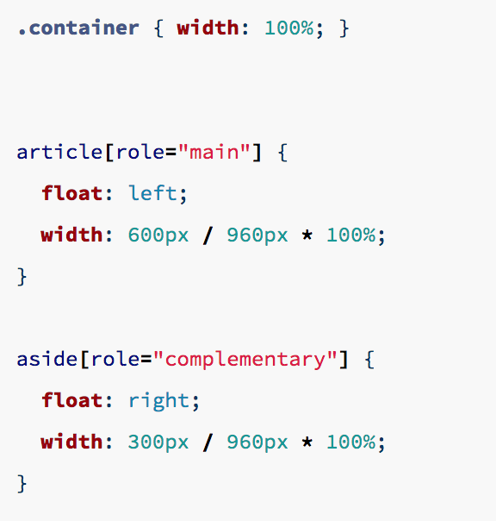
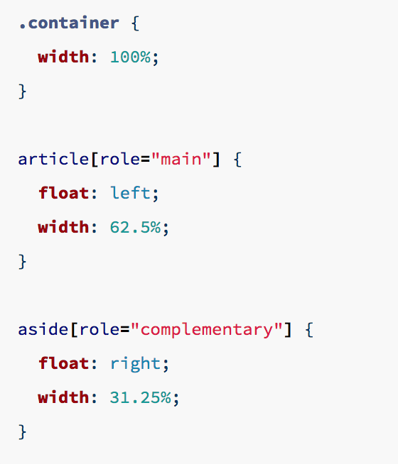
Operators
SCSS
CSS
Notes:
operators
do math instead of figuring it all out

Slide 27
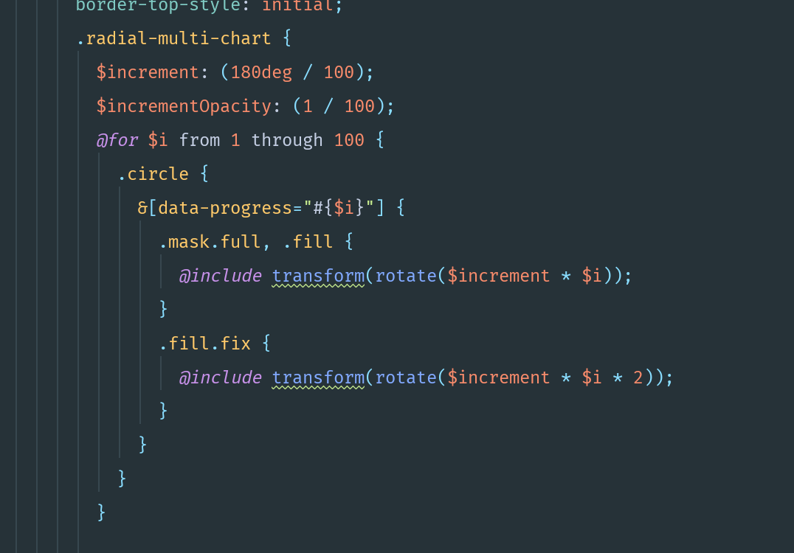
Functions
CoSchedule
Headline Analyzer
Notes:
functions
headline analyzer example
for loop
generates 100 different rotation options
based on the data attribute, tells the CSS which one to use to animate

Slide 28
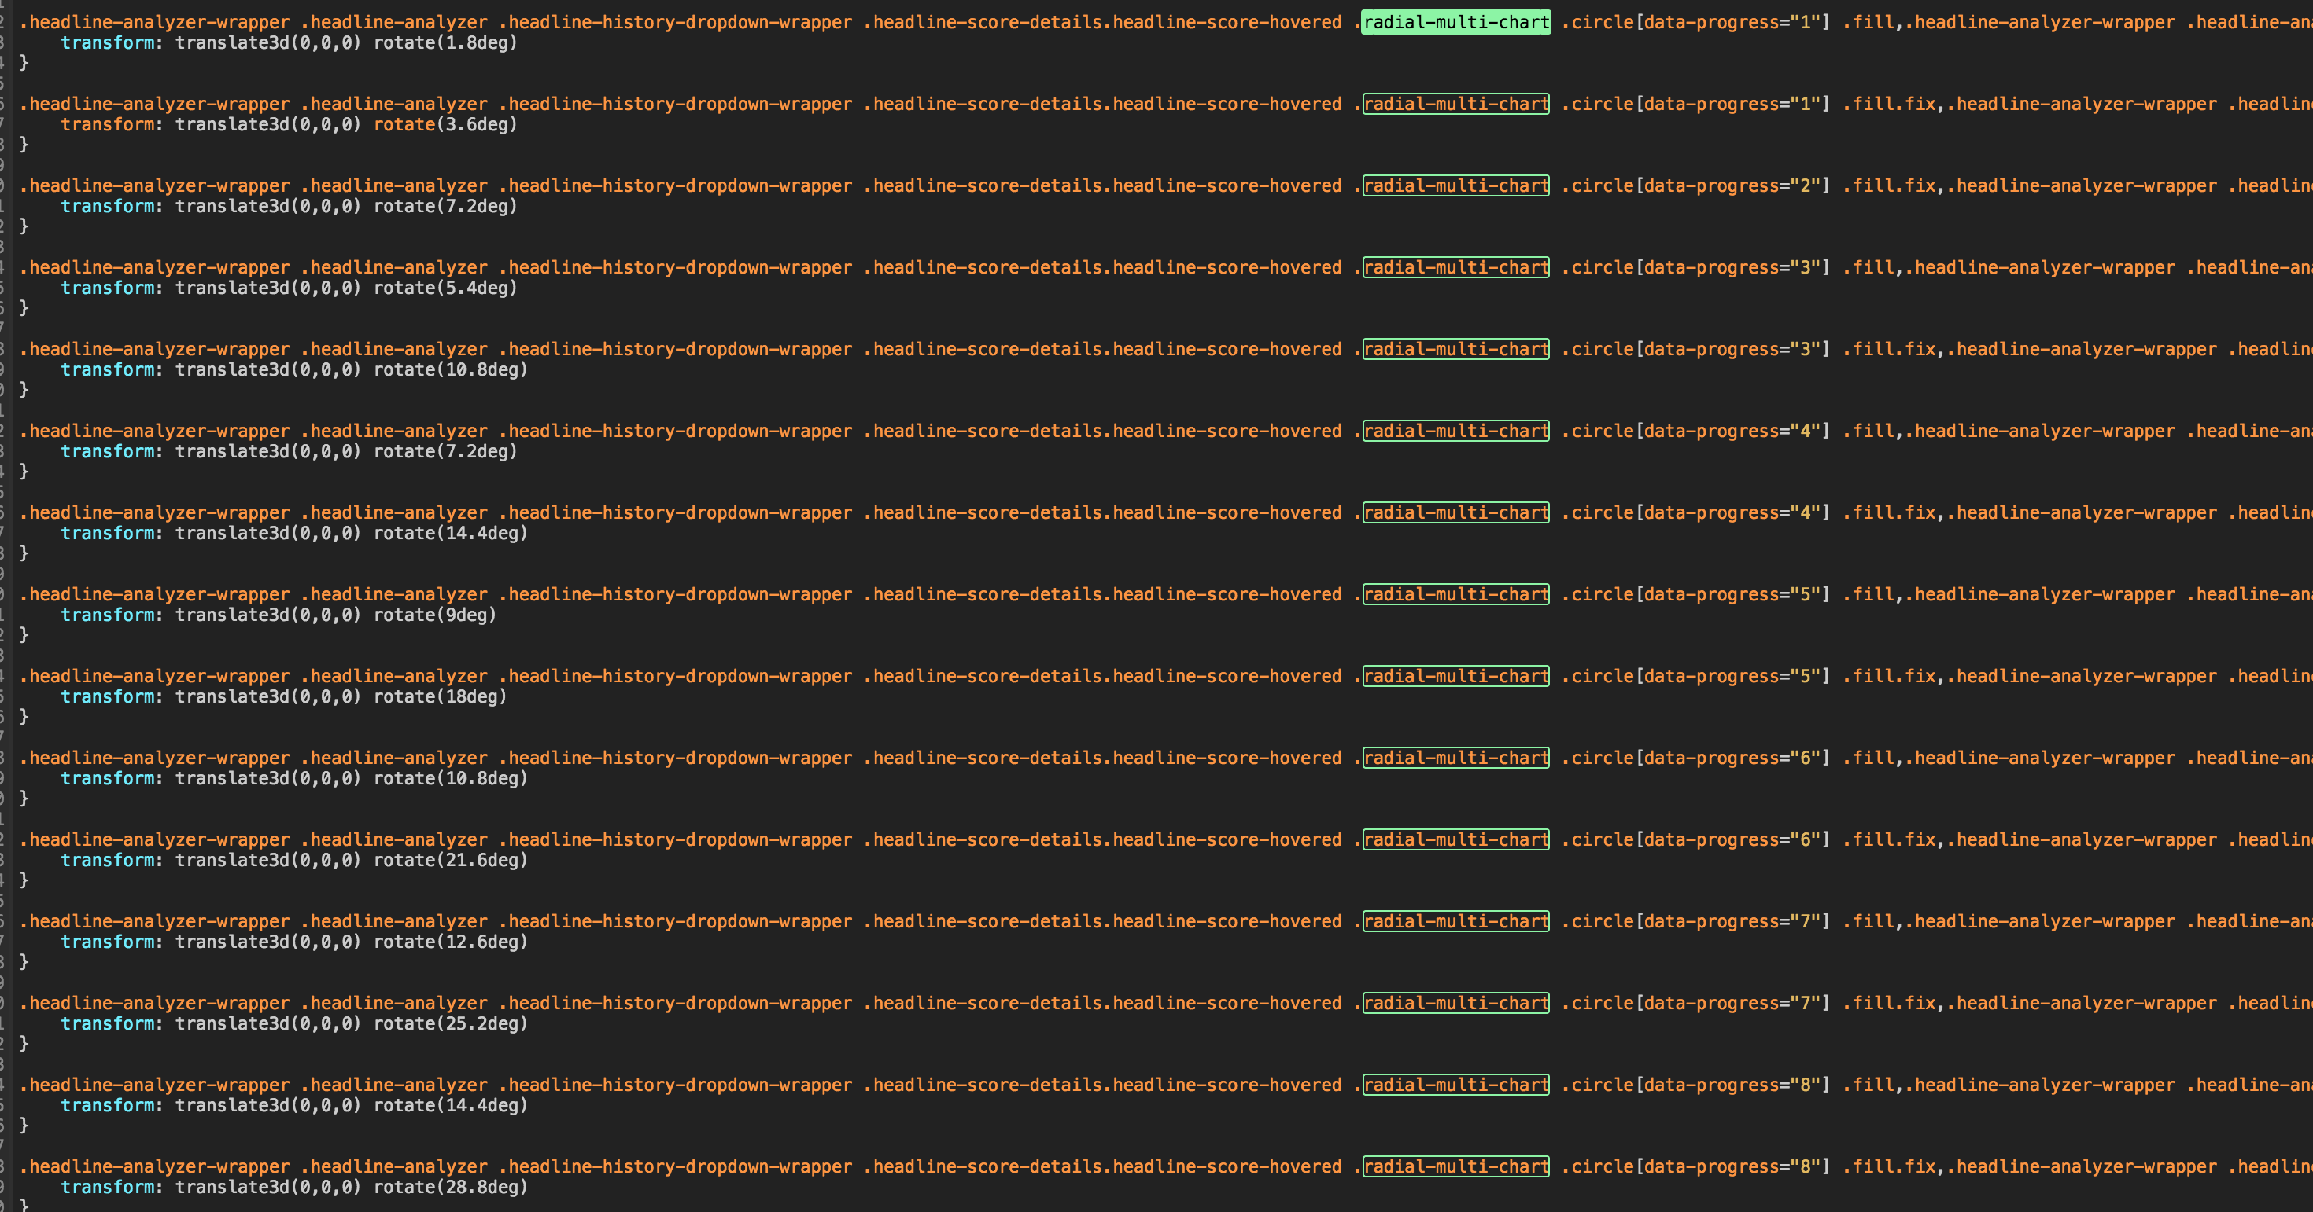
Notes:
only 1/10 of all the CSS that gets compiled by that for loop

Slide 29
Thank You!
J.Morgan Legreid
UX/UI Designer | CoSchedule
@jlegreid
sass-lang.com/guide
Notes:
only the tip of the ice berg, but overall SCSS is more complicated to learn but once you get good at it you can save a ton of time by writing fewer lines with more logic

